Slide 1
השיעור יתחיל ב- 12:15

Slide 2
Introduction to Python for Social Sciences
Iftach Amir, PhD

Slide 3
Basic Information
Course name: Introduction to Python for Social Sciences
Time: Sunday, 1215 - 1545
Instructors: Iftach Amir
Email: iftach.amir@gmail.com
Consult. hours: Flexible, arrange through mail

Slide 4
Goals:
Learn basic concepts in programming
Develop skills to (continue) learning by yourself from on-line resources and examples
Develop confidence to continue working with Python for *your* specific research needs.

Slide 5
Goals:
Familiarity with Python

Slide 6

Why should I learn Python (as a researcher)?
(or why is my department making me learn this?)

Slide 7
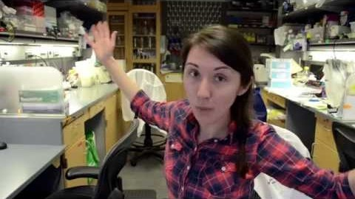

Slide 8
“The difficult part of learning to program lies with the fundamentals … once a researcher has those nailed down, adapting to a new language is just a matter of syntax. … What matters most in the early stages is having a good support network. … Pick the programming language based on what people around you are using, Increasingly, that language is Python.”
(link)

Slide 9
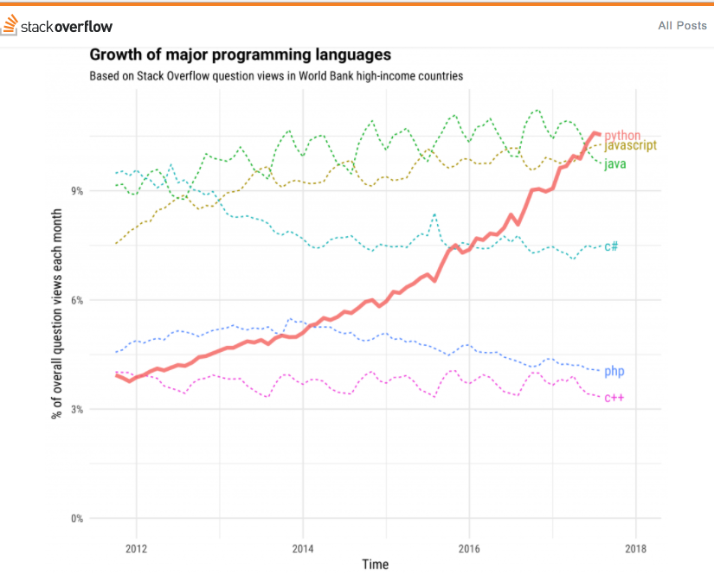
Also - TIOBE Index

Slide 10
Course requirements:
Attend and participate.
Complete readings and assignments before class.
End of course project.

Slide 11
Let’s get started

Slide 12
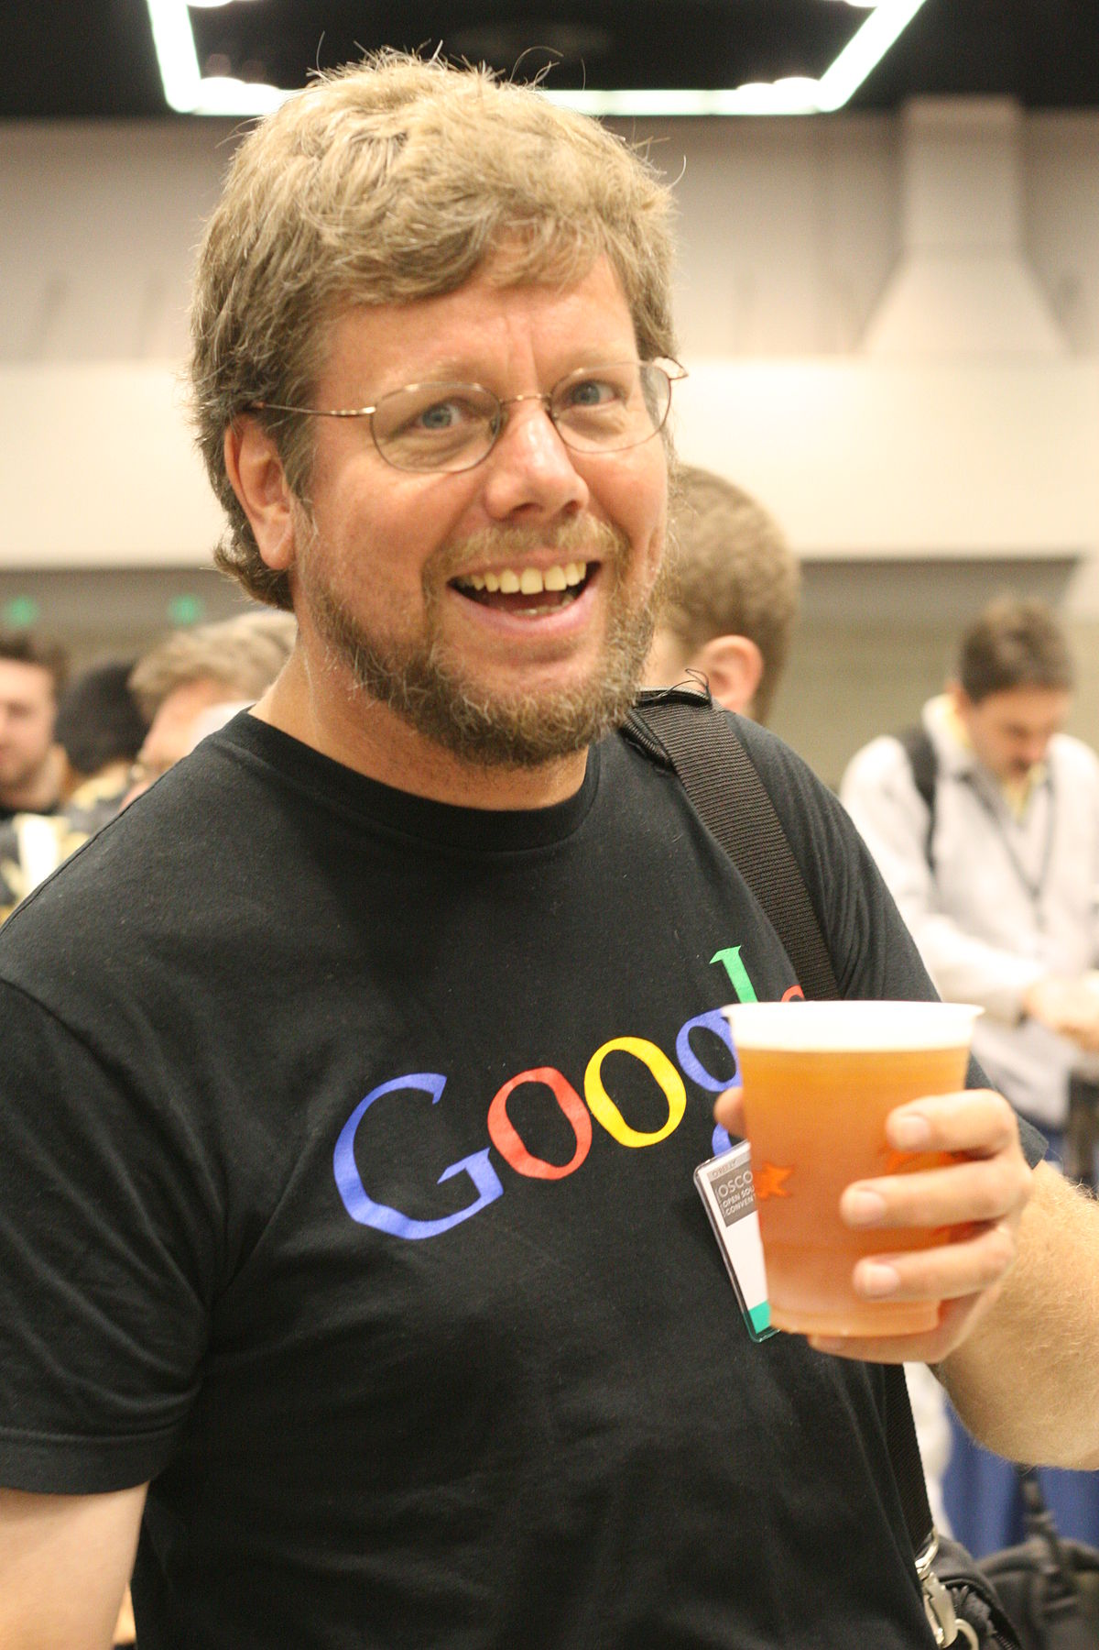

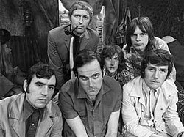

Slide 13

Video #1

Slide 14
print()

Slide 15
print()
print(“Hello world”)
parentheses
(function input)
function name

Slide 16
print()
print(“Hello world”)
Syntax errors
Runtime errors

Slide 17
print()
print(5)
print(5+5)

Slide 18
Operators
A symbol that performs an operation on two inputs / variables, e.g.:
+
-
=

Slide 19
Basic math operations
also here

Slide 20

REPL
Read Evaluate Print Loop

Slide 21
Open repl.it and create an account

Slide 22
Script window
Interactive window

Slide 23
Open repl.it →
0.1. “Basic math operators”

Slide 24
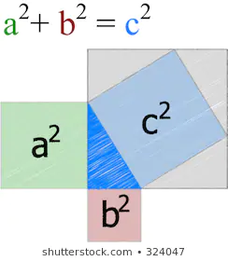
Variables and Assignments
What is a variable?
What is an assignment?
What is a valid variable name?

Slide 25
Variables and Assignments
What is a variable?

Slide 26
Variables and Assignments
What is an assignment?
X = 4
X ← 4

Slide 27
Variables and Assignments
What is a valid variable name?
Can’t start with a number
Can’t be a keyword ‘reserved’ for Python, e.g.:
return
global
Remember to give it a short, meaningful name
Use “_” character if you want to use more than one word
Variable names are case sensitive (small / capital letters)

Slide 28
Keep your code readable
Give your variables descriptive names (better than short names)
Use “ _ “ to separate words in variable name

Slide 29
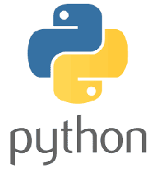
Variables and Assignments
Multiple assignment:
variable1, variable2 = value1, value2
x, y, z = 1, 2, 3

Slide 30
Fundamental variable types
Strings
Integer (number)
Float (number)
Boolean (True/False)
* duck typing

Slide 31
Variable types
Strings → str()
Integer (number) → int()
Float (number) → float()

Slide 32
type()
print()
input()
int()

Slide 33
x = int(input())
what’s going on here???

Slide 34

Before you continue to some exercises...
The importance of documenting your code

Slide 35

Conventions for writing Python code - PEP8

Slide 36
# Calculate mass of water molecule and output it
# to console
h2oOxygens = 1
h2oHydrogens = 2
oxygenMass = 15.9994
hydrogenMass = 1.00794
h2oMass = .....
print('Molecular weight of H20 = ',h2oMass)

Slide 37
Continue doing exercises 1.1 to 1.4, behatzlacha.

